Slide 1

RCNN Family --- Object detection meet CNN
Student Yipeng Zhang(yz4895)
Student Yunfei Ke (yk3108)
Student Haoyu Dong (hd2573)
EECS E6691 Advanced Deep Learning, 2025 Spring

Slide 2
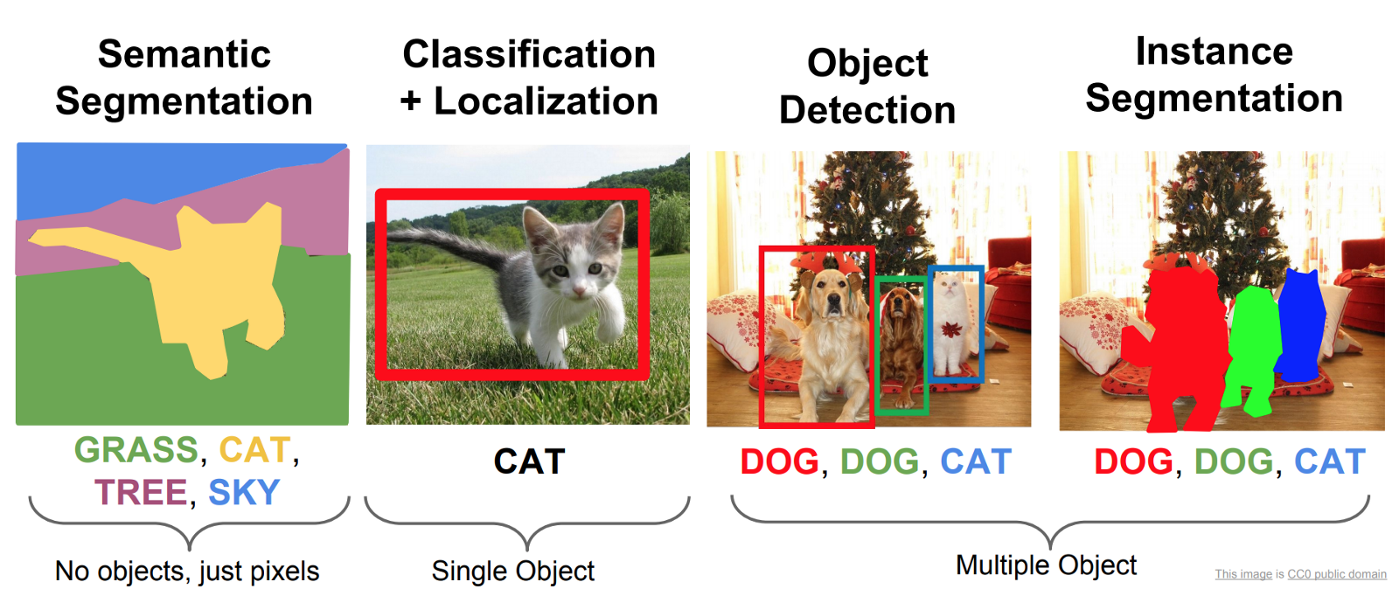
RCNN: Object Detection via CNN and Selective Region Search
Reviewing the Differences Between CV Tasks
https://www.researchgate.net/figure/Comparison-of-the-four-common-tasks-in-Computer-Vision-19_fig3_364027211

Slide 3
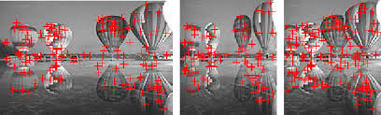
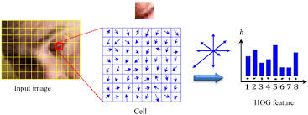
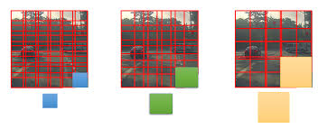
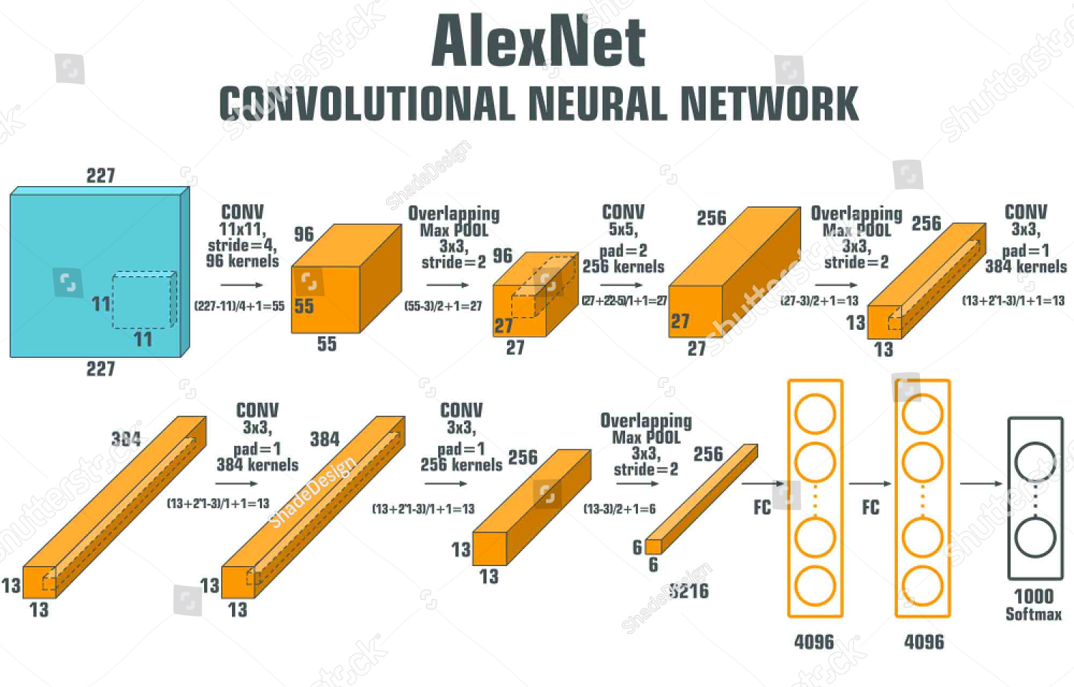
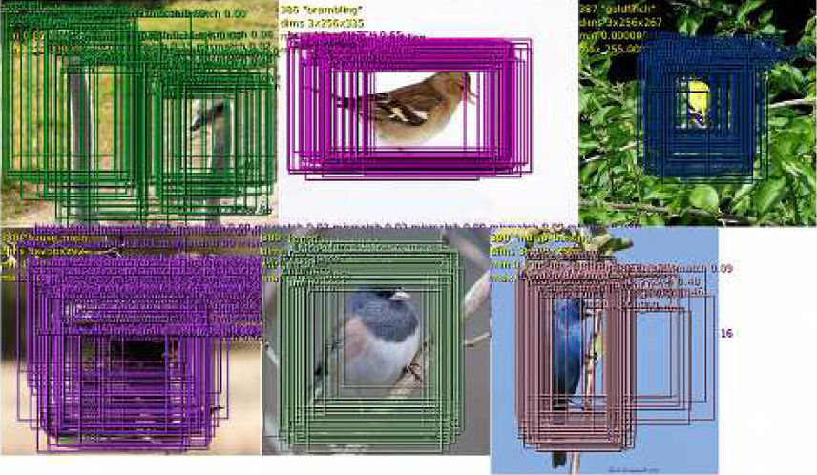
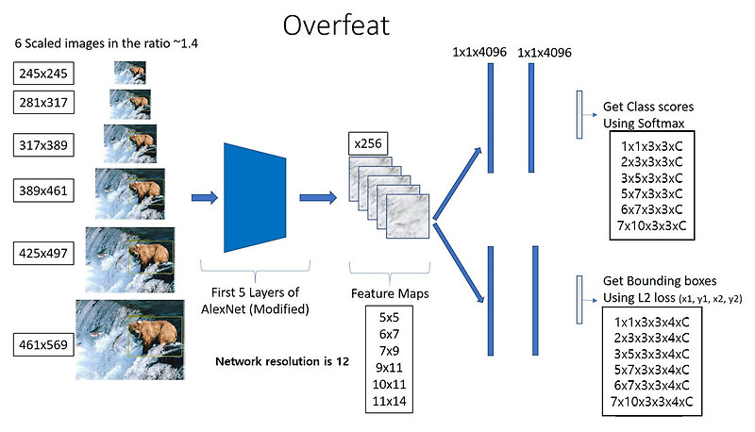
Back to 2014
Feature Extraction :handcrafted features(e.g. SIFT and HOG)
Detection window: Sliding Window Detection Methods
In picture classification problem
In object detection problem
Notes:
Traditional Feature Extraction Methods
Traditional object detection methods primarily relied on handcrafted features such as SIFT (Scale-Invariant Feature Transform) and HOG (Histograms of Oriented Gradients). These features were designed to extract local gradients and texture information from images, mimicking the functionality of complex cells in the primary visual cortex (V1) of the human visual system. While these methods performed well in simple scenarios, they struggled to capture high-level semantic information in complex scenes, which limited their effectiveness in object detection tasks.
Sliding Window Detection Methods
The sliding window approach was another widely used method for object detection. This method involved sliding a fixed-size window across the image at various scales and positions, classifying each window to detect objects. However, this approach had significant drawbacks:
High Computational Cost: The exhaustive search over all possible windows made it computationally expensive, especially for high-resolution images.
Limited Adaptability: It struggled to handle the diversity of objects in terms of scale, shape, and pose, making it less effective in real-world scenarios.
Limitations of Traditional Object Detection
1. Data Scarcity
Object detection requires precise bounding box annotations for training, which are expensive and time-consuming to obtain. The scarcity of labeled data made it challenging to train high-capacity models, limiting their generalization ability and performance.
2. Performance Bottleneck
On the PASCAL VOC dataset, the performance of traditional methods stagnated between 2010 and 2012. The key performance metric, mAP (mean Average Precision), measures the average detection precision across all object categories. Traditional methods, such as the Deformable Part Models (DPM) based on HOG features, achieved an mAP of only 33.4%, with little improvement over time.
In contrast, RCNN introduced a significant breakthrough, achieving an mAP of 53.3% on the PASCAL VOC 2012 dataset, representing a relative improvement of over 30%. This marked a turning point in object detection, leveraging the power of convolutional neural networks (CNNs) and region proposals to overcome the limitations of traditional methods.

Slide 4
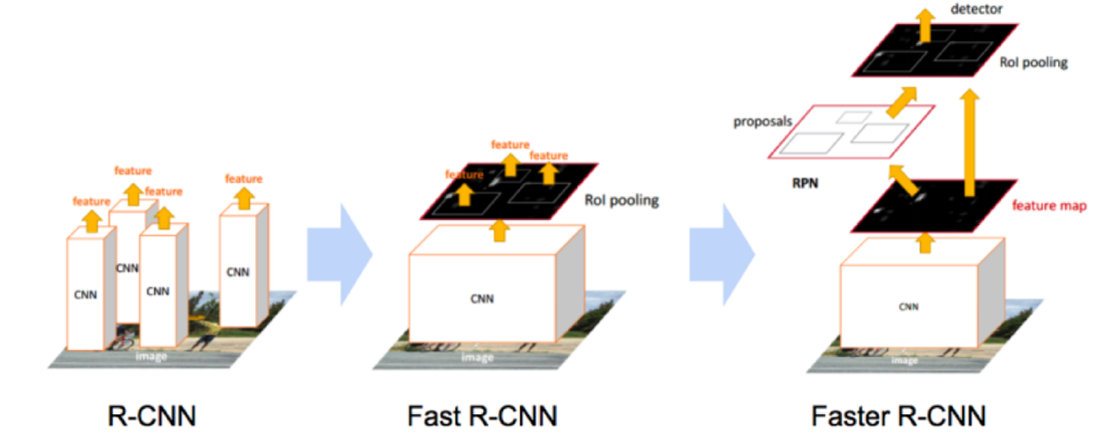

RCNN series of algorithms
Region Proposal
+
CNN network
2014/06
CVPR 2014
2015/4/30
ICCV 2015
2015/6/4
NIPS 2015
https://www.researchgate.net/figure/Comparison-of-the-four-common-tasks-in-Computer-Vision-19_fig3_364027211

Slide 5
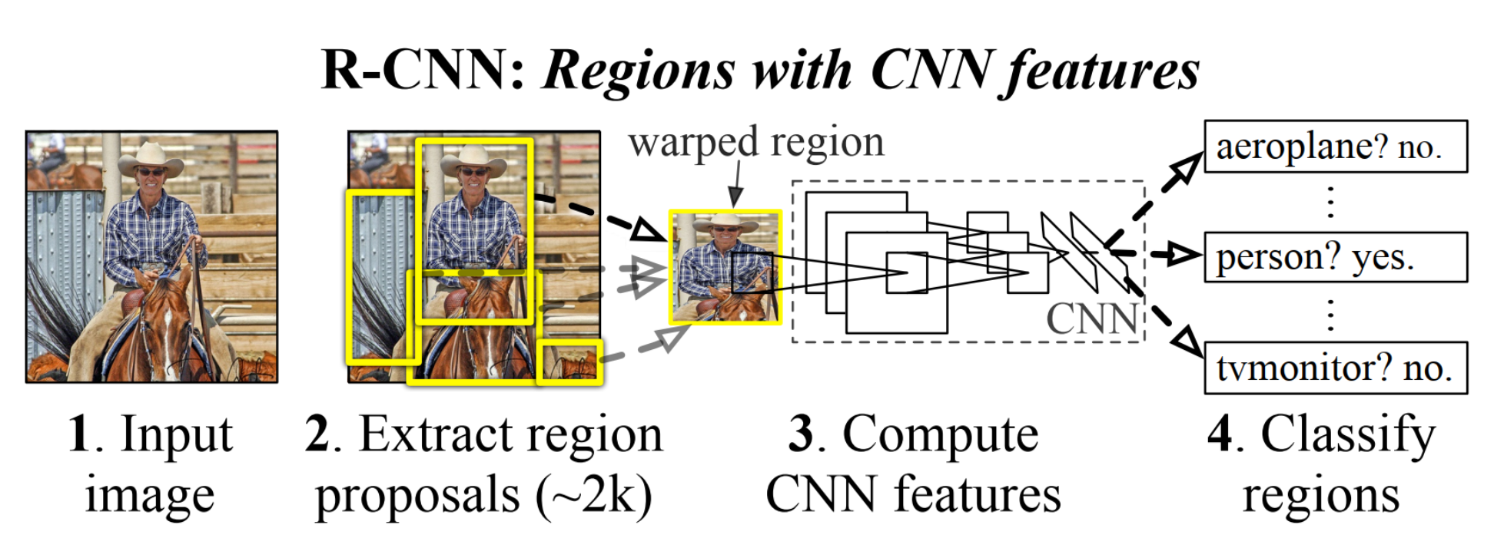
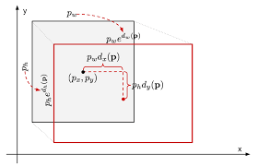
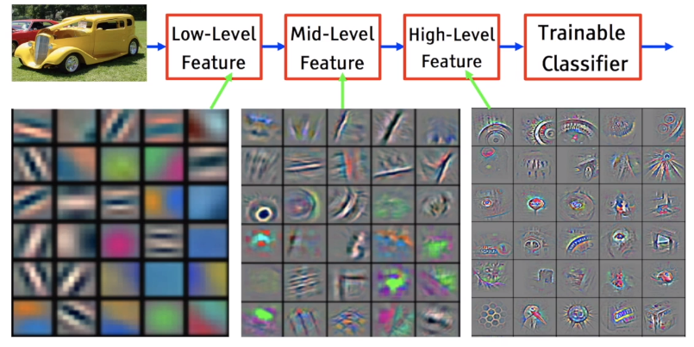
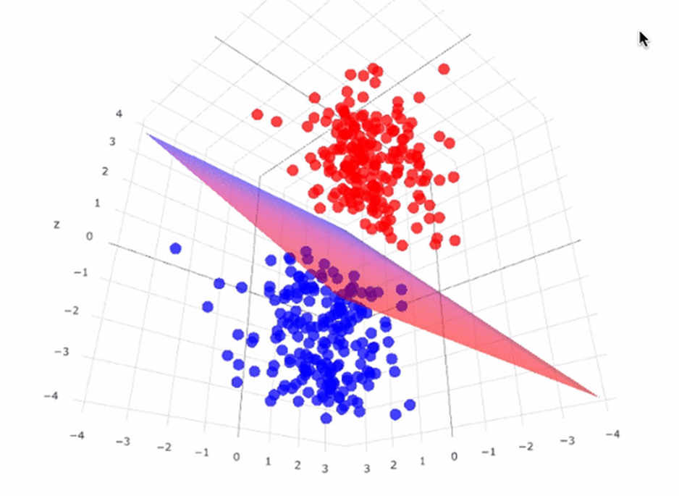
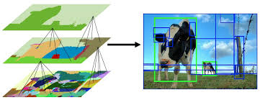
RCNN process
https://arxiv.org/abs/1311.2524
4096-dimensional vector
4.Localization
Bounding box refining
3.SVMs(K+1)
K→classes
1.Selective Search
2.CNN Feature extraction

Slide 6
Outline for basic RCNN
Limitations of Traditional Object Detection
Region Proposal: Selective Search
Region Warping: Scaling Regions to Uniform Sizes
CNN Feature Extraction
Supervised Pre-training and fine-tuning
SVM for Object Classification
Intersection Over Union (IOU) metric
Non-Maximum Suppression (NMS) for filtering proposals
Localization: Bounding Box Regression for Precise Localization
The experimental results from the RCNN paper

Slide 7
RCNN: Object Detection via CNN and Selective Region Search
Limitations of 2014 Object Detection
Data Scarcity
Classification dataset: ImageNet
training set >1200000
Object Detection dataset: PASCAL VOC 2012
training set <10000
→Perform supervised pre-training on a large dataset, then fine-tune
Sliding windows has too many windows:
How to obtain accurate windows with fewer attempts?
1.Use Selective Search to get region proposals
2.Perform a regression to get the precise position and size of bounding boxes
Notes:
Traditional Feature Extraction Methods
Traditional object detection methods primarily relied on handcrafted features such as SIFT (Scale-Invariant Feature Transform) and HOG (Histograms of Oriented Gradients). These features were designed to extract local gradients and texture information from images, mimicking the functionality of complex cells in the primary visual cortex (V1) of the human visual system. While these methods performed well in simple scenarios, they struggled to capture high-level semantic information in complex scenes, which limited their effectiveness in object detection tasks.
Sliding Window Detection Methods
The sliding window approach was another widely used method for object detection. This method involved sliding a fixed-size window across the image at various scales and positions, classifying each window to detect objects. However, this approach had significant drawbacks:
High Computational Cost: The exhaustive search over all possible windows made it computationally expensive, especially for high-resolution images.
Limited Adaptability: It struggled to handle the diversity of objects in terms of scale, shape, and pose, making it less effective in real-world scenarios.
Limitations of Traditional Object Detection
1. Data Scarcity
Object detection requires precise bounding box annotations for training, which are expensive and time-consuming to obtain. The scarcity of labeled data made it challenging to train high-capacity models, limiting their generalization ability and performance.
2. Performance Bottleneck
On the PASCAL VOC dataset, the performance of traditional methods stagnated between 2010 and 2012. The key performance metric, mAP (mean Average Precision), measures the average detection precision across all object categories. Traditional methods, such as the Deformable Part Models (DPM) based on HOG features, achieved an mAP of only 33.4%, with little improvement over time.
In contrast, RCNN introduced a significant breakthrough, achieving an mAP of 53.3% on the PASCAL VOC 2012 dataset, representing a relative improvement of over 30%. This marked a turning point in object detection, leveraging the power of convolutional neural networks (CNNs) and region proposals to overcome the limitations of traditional methods.

Slide 8
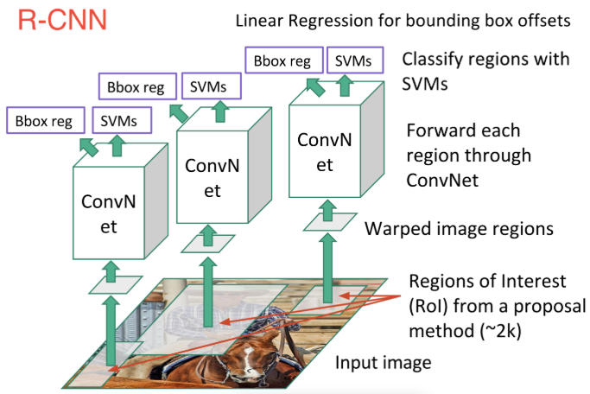
RCNN Overview
https://medium.com/towards-data-science/deep-learning-for-object-detection-a-comprehensive-review-73930816d8d9
Notes:
Traditional Feature Extraction Methods
Traditional object detection methods primarily relied on handcrafted features such as SIFT (Scale-Invariant Feature Transform) and HOG (Histograms of Oriented Gradients). These features were designed to extract local gradients and texture information from images, mimicking the functionality of complex cells in the primary visual cortex (V1) of the human visual system. While these methods performed well in simple scenarios, they struggled to capture high-level semantic information in complex scenes, which limited their effectiveness in object detection tasks.
Sliding Window Detection Methods
The sliding window approach was another widely used method for object detection. This method involved sliding a fixed-size window across the image at various scales and positions, classifying each window to detect objects. However, this approach had significant drawbacks:
High Computational Cost: The exhaustive search over all possible windows made it computationally expensive, especially for high-resolution images.
Limited Adaptability: It struggled to handle the diversity of objects in terms of scale, shape, and pose, making it less effective in real-world scenarios.
Limitations of Traditional Object Detection
1. Data Scarcity
Object detection requires precise bounding box annotations for training, which are expensive and time-consuming to obtain. The scarcity of labeled data made it challenging to train high-capacity models, limiting their generalization ability and performance.
2. Performance Bottleneck
On the PASCAL VOC dataset, the performance of traditional methods stagnated between 2010 and 2012. The key performance metric, mAP (mean Average Precision), measures the average detection precision across all object categories. Traditional methods, such as the Deformable Part Models (DPM) based on HOG features, achieved an mAP of only 33.4%, with little improvement over time.
In contrast, RCNN introduced a significant breakthrough, achieving an mAP of 53.3% on the PASCAL VOC 2012 dataset, representing a relative improvement of over 30%. This marked a turning point in object detection, leveraging the power of convolutional neural networks (CNNs) and region proposals to overcome the limitations of traditional methods.

Slide 9
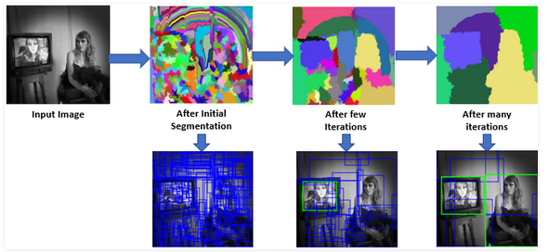
How to get windows for identifiable objects
Region Proposal: Selective Search
Selective Search first segments regions based on color, texture, size, and shape,
then merges similar regions using measures like color, texture, size similarity, and fill.
Notes:
Traditional Feature Extraction Methods
Traditional object detection methods primarily relied on handcrafted features such as SIFT (Scale-Invariant Feature Transform) and HOG (Histograms of Oriented Gradients). These features were designed to extract local gradients and texture information from images, mimicking the functionality of complex cells in the primary visual cortex (V1) of the human visual system. While these methods performed well in simple scenarios, they struggled to capture high-level semantic information in complex scenes, which limited their effectiveness in object detection tasks.
Sliding Window Detection Methods
The sliding window approach was another widely used method for object detection. This method involved sliding a fixed-size window across the image at various scales and positions, classifying each window to detect objects. However, this approach had significant drawbacks:
High Computational Cost: The exhaustive search over all possible windows made it computationally expensive, especially for high-resolution images.
Limited Adaptability: It struggled to handle the diversity of objects in terms of scale, shape, and pose, making it less effective in real-world scenarios.
Limitations of Traditional Object Detection
1. Data Scarcity
Object detection requires precise bounding box annotations for training, which are expensive and time-consuming to obtain. The scarcity of labeled data made it challenging to train high-capacity models, limiting their generalization ability and performance.
2. Performance Bottleneck
On the PASCAL VOC dataset, the performance of traditional methods stagnated between 2010 and 2012. The key performance metric, mAP (mean Average Precision), measures the average detection precision across all object categories. Traditional methods, such as the Deformable Part Models (DPM) based on HOG features, achieved an mAP of only 33.4%, with little improvement over time.
In contrast, RCNN introduced a significant breakthrough, achieving an mAP of 53.3% on the PASCAL VOC 2012 dataset, representing a relative improvement of over 30%. This marked a turning point in object detection, leveraging the power of convolutional neural networks (CNNs) and region proposals to overcome the limitations of traditional methods.

Slide 10
RCNN Overview
https://medium.com/towards-data-science/deep-learning-for-object-detection-a-comprehensive-review-73930816d8d9
Notes:
Traditional Feature Extraction Methods
Traditional object detection methods primarily relied on handcrafted features such as SIFT (Scale-Invariant Feature Transform) and HOG (Histograms of Oriented Gradients). These features were designed to extract local gradients and texture information from images, mimicking the functionality of complex cells in the primary visual cortex (V1) of the human visual system. While these methods performed well in simple scenarios, they struggled to capture high-level semantic information in complex scenes, which limited their effectiveness in object detection tasks.
Sliding Window Detection Methods
The sliding window approach was another widely used method for object detection. This method involved sliding a fixed-size window across the image at various scales and positions, classifying each window to detect objects. However, this approach had significant drawbacks:
High Computational Cost: The exhaustive search over all possible windows made it computationally expensive, especially for high-resolution images.
Limited Adaptability: It struggled to handle the diversity of objects in terms of scale, shape, and pose, making it less effective in real-world scenarios.
Limitations of Traditional Object Detection
1. Data Scarcity
Object detection requires precise bounding box annotations for training, which are expensive and time-consuming to obtain. The scarcity of labeled data made it challenging to train high-capacity models, limiting their generalization ability and performance.
2. Performance Bottleneck
On the PASCAL VOC dataset, the performance of traditional methods stagnated between 2010 and 2012. The key performance metric, mAP (mean Average Precision), measures the average detection precision across all object categories. Traditional methods, such as the Deformable Part Models (DPM) based on HOG features, achieved an mAP of only 33.4%, with little improvement over time.
In contrast, RCNN introduced a significant breakthrough, achieving an mAP of 53.3% on the PASCAL VOC 2012 dataset, representing a relative improvement of over 30%. This marked a turning point in object detection, leveraging the power of convolutional neural networks (CNNs) and region proposals to overcome the limitations of traditional methods.

Slide 11
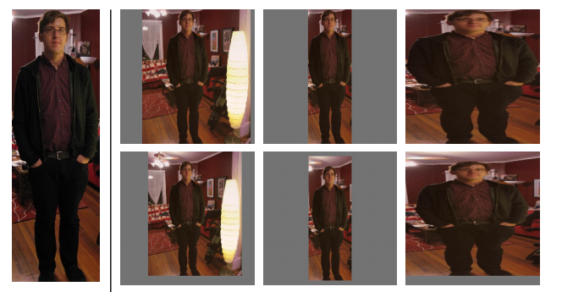
Region Warping
https://arxiv.org/abs/1311.2524
Scaling Regions to Uniform Sizes
The method in the second row, third column of the image corresponds to isotropic scaling with padding. This approach involves the following steps:
Bounding Box Expansion-->2.Context Inclusion-->3.Resizing
Notes:
The method in the second row, third column of the image corresponds to isotropic scaling with padding. This approach involves the following steps:
Bounding Box Expansion: The bounding box of the region proposal is expanded to form a square by adding padding around the edges. This ensures the aspect ratio is preserved.
Context Inclusion: The padding includes a fixed number of pixels (e.g., 16) to retain some contextual information around the object.
Resizing: The expanded square region is then resized isotropically to the fixed input size required by the CNN (e.g., 227×227 pixels).

Slide 12
RCNN Overview
https://medium.com/towards-data-science/deep-learning-for-object-detection-a-comprehensive-review-73930816d8d9
Notes:
Traditional Feature Extraction Methods
Traditional object detection methods primarily relied on handcrafted features such as SIFT (Scale-Invariant Feature Transform) and HOG (Histograms of Oriented Gradients). These features were designed to extract local gradients and texture information from images, mimicking the functionality of complex cells in the primary visual cortex (V1) of the human visual system. While these methods performed well in simple scenarios, they struggled to capture high-level semantic information in complex scenes, which limited their effectiveness in object detection tasks.
Sliding Window Detection Methods
The sliding window approach was another widely used method for object detection. This method involved sliding a fixed-size window across the image at various scales and positions, classifying each window to detect objects. However, this approach had significant drawbacks:
High Computational Cost: The exhaustive search over all possible windows made it computationally expensive, especially for high-resolution images.
Limited Adaptability: It struggled to handle the diversity of objects in terms of scale, shape, and pose, making it less effective in real-world scenarios.
Limitations of Traditional Object Detection
1. Data Scarcity
Object detection requires precise bounding box annotations for training, which are expensive and time-consuming to obtain. The scarcity of labeled data made it challenging to train high-capacity models, limiting their generalization ability and performance.
2. Performance Bottleneck
On the PASCAL VOC dataset, the performance of traditional methods stagnated between 2010 and 2012. The key performance metric, mAP (mean Average Precision), measures the average detection precision across all object categories. Traditional methods, such as the Deformable Part Models (DPM) based on HOG features, achieved an mAP of only 33.4%, with little improvement over time.
In contrast, RCNN introduced a significant breakthrough, achieving an mAP of 53.3% on the PASCAL VOC 2012 dataset, representing a relative improvement of over 30%. This marked a turning point in object detection, leveraging the power of convolutional neural networks (CNNs) and region proposals to overcome the limitations of traditional methods.

Slide 13
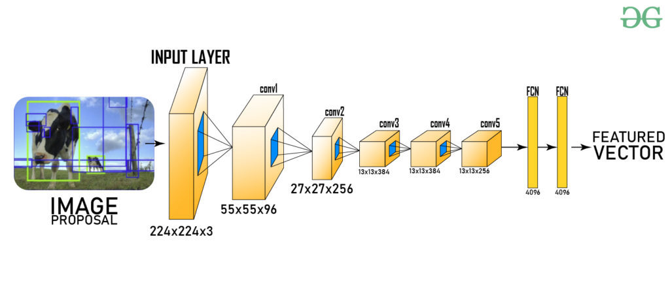
CNN Feature Extraction: RCNN network layers
After pooling
6*6*256
Region proposal is warped to a fixed size (e.g., 224×224 pixels) to match the input requirements of CNN.
The CNN, based on the architecture proposed by Krizhevsky et al. (AlexNet), extracts a 4096-dimensional feature vector for each region.
The CNN consists of:
Five convolutional layers for feature extraction.
Two fully connected layers for high-level feature representation.
Notes:
Traditional Feature Extraction Methods
Traditional object detection methods primarily relied on handcrafted features such as SIFT (Scale-Invariant Feature Transform) and HOG (Histograms of Oriented Gradients). These features were designed to extract local gradients and texture information from images, mimicking the functionality of complex cells in the primary visual cortex (V1) of the human visual system. While these methods performed well in simple scenarios, they struggled to capture high-level semantic information in complex scenes, which limited their effectiveness in object detection tasks.
Sliding Window Detection Methods
The sliding window approach was another widely used method for object detection. This method involved sliding a fixed-size window across the image at various scales and positions, classifying each window to detect objects. However, this approach had significant drawbacks:
High Computational Cost: The exhaustive search over all possible windows made it computationally expensive, especially for high-resolution images.
Limited Adaptability: It struggled to handle the diversity of objects in terms of scale, shape, and pose, making it less effective in real-world scenarios.
Limitations of Traditional Object Detection
1. Data Scarcity
Object detection requires precise bounding box annotations for training, which are expensive and time-consuming to obtain. The scarcity of labeled data made it challenging to train high-capacity models, limiting their generalization ability and performance.
2. Performance Bottleneck
On the PASCAL VOC dataset, the performance of traditional methods stagnated between 2010 and 2012. The key performance metric, mAP (mean Average Precision), measures the average detection precision across all object categories. Traditional methods, such as the Deformable Part Models (DPM) based on HOG features, achieved an mAP of only 33.4%, with little improvement over time.
In contrast, RCNN introduced a significant breakthrough, achieving an mAP of 53.3% on the PASCAL VOC 2012 dataset, representing a relative improvement of over 30%. This marked a turning point in object detection, leveraging the power of convolutional neural networks (CNNs) and region proposals to overcome the limitations of traditional methods.

Slide 14
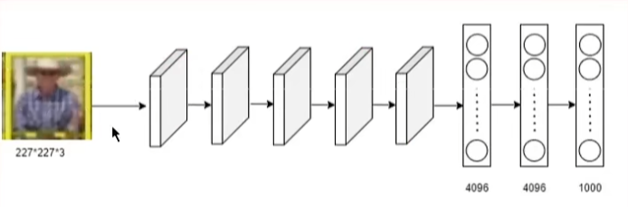
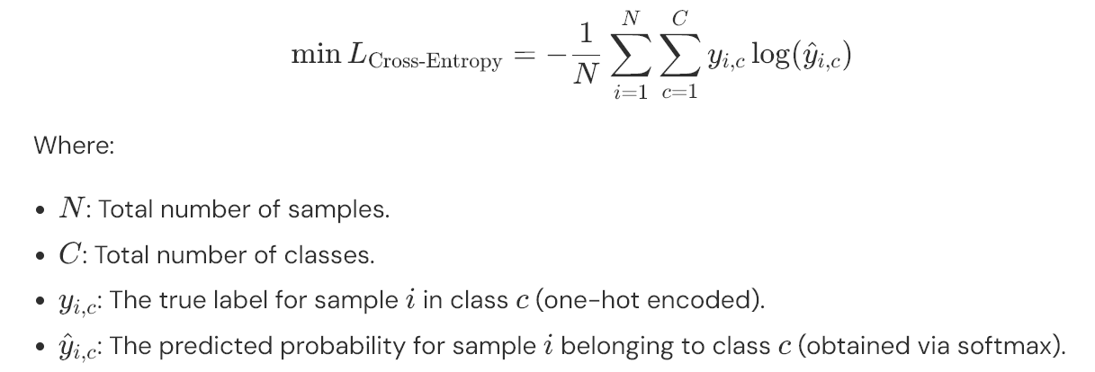
RCNN: Object Detection via CNN and Selective Region Search
https://arxiv.org/abs/1311.2524
Supervised Pre-training and fine-tuning
Frozen during fine-tuning
By pre-training the CNN on ImageNet, the model learns generalizable features from abundant labeled data(more than 1200000 pictures). Fine-tuning on PASCAL VOC then adapts these features to the specific task of object detection, addressing the challenge of limited labeled data in the target domain.
Notes:
Traditional Feature Extraction Methods
Traditional object detection methods primarily relied on handcrafted features such as SIFT (Scale-Invariant Feature Transform) and HOG (Histograms of Oriented Gradients). These features were designed to extract local gradients and texture information from images, mimicking the functionality of complex cells in the primary visual cortex (V1) of the human visual system. While these methods performed well in simple scenarios, they struggled to capture high-level semantic information in complex scenes, which limited their effectiveness in object detection tasks.
Sliding Window Detection Methods
The sliding window approach was another widely used method for object detection. This method involved sliding a fixed-size window across the image at various scales and positions, classifying each window to detect objects. However, this approach had significant drawbacks:
High Computational Cost: The exhaustive search over all possible windows made it computationally expensive, especially for high-resolution images.
Limited Adaptability: It struggled to handle the diversity of objects in terms of scale, shape, and pose, making it less effective in real-world scenarios.
Limitations of Traditional Object Detection
1. Data Scarcity
Object detection requires precise bounding box annotations for training, which are expensive and time-consuming to obtain. The scarcity of labeled data made it challenging to train high-capacity models, limiting their generalization ability and performance.
2. Performance Bottleneck
On the PASCAL VOC dataset, the performance of traditional methods stagnated between 2010 and 2012. The key performance metric, mAP (mean Average Precision), measures the average detection precision across all object categories. Traditional methods, such as the Deformable Part Models (DPM) based on HOG features, achieved an mAP of only 33.4%, with little improvement over time.
In contrast, RCNN introduced a significant breakthrough, achieving an mAP of 53.3% on the PASCAL VOC 2012 dataset, representing a relative improvement of over 30%. This marked a turning point in object detection, leveraging the power of convolutional neural networks (CNNs) and region proposals to overcome the limitations of traditional methods.

Slide 15
RCNN Overview
https://medium.com/towards-data-science/deep-learning-for-object-detection-a-comprehensive-review-73930816d8d9
Notes:
Traditional Feature Extraction Methods
Traditional object detection methods primarily relied on handcrafted features such as SIFT (Scale-Invariant Feature Transform) and HOG (Histograms of Oriented Gradients). These features were designed to extract local gradients and texture information from images, mimicking the functionality of complex cells in the primary visual cortex (V1) of the human visual system. While these methods performed well in simple scenarios, they struggled to capture high-level semantic information in complex scenes, which limited their effectiveness in object detection tasks.
Sliding Window Detection Methods
The sliding window approach was another widely used method for object detection. This method involved sliding a fixed-size window across the image at various scales and positions, classifying each window to detect objects. However, this approach had significant drawbacks:
High Computational Cost: The exhaustive search over all possible windows made it computationally expensive, especially for high-resolution images.
Limited Adaptability: It struggled to handle the diversity of objects in terms of scale, shape, and pose, making it less effective in real-world scenarios.
Limitations of Traditional Object Detection
1. Data Scarcity
Object detection requires precise bounding box annotations for training, which are expensive and time-consuming to obtain. The scarcity of labeled data made it challenging to train high-capacity models, limiting their generalization ability and performance.
2. Performance Bottleneck
On the PASCAL VOC dataset, the performance of traditional methods stagnated between 2010 and 2012. The key performance metric, mAP (mean Average Precision), measures the average detection precision across all object categories. Traditional methods, such as the Deformable Part Models (DPM) based on HOG features, achieved an mAP of only 33.4%, with little improvement over time.
In contrast, RCNN introduced a significant breakthrough, achieving an mAP of 53.3% on the PASCAL VOC 2012 dataset, representing a relative improvement of over 30%. This marked a turning point in object detection, leveraging the power of convolutional neural networks (CNNs) and region proposals to overcome the limitations of traditional methods.

Slide 16
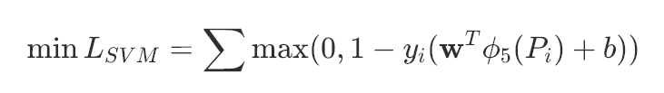
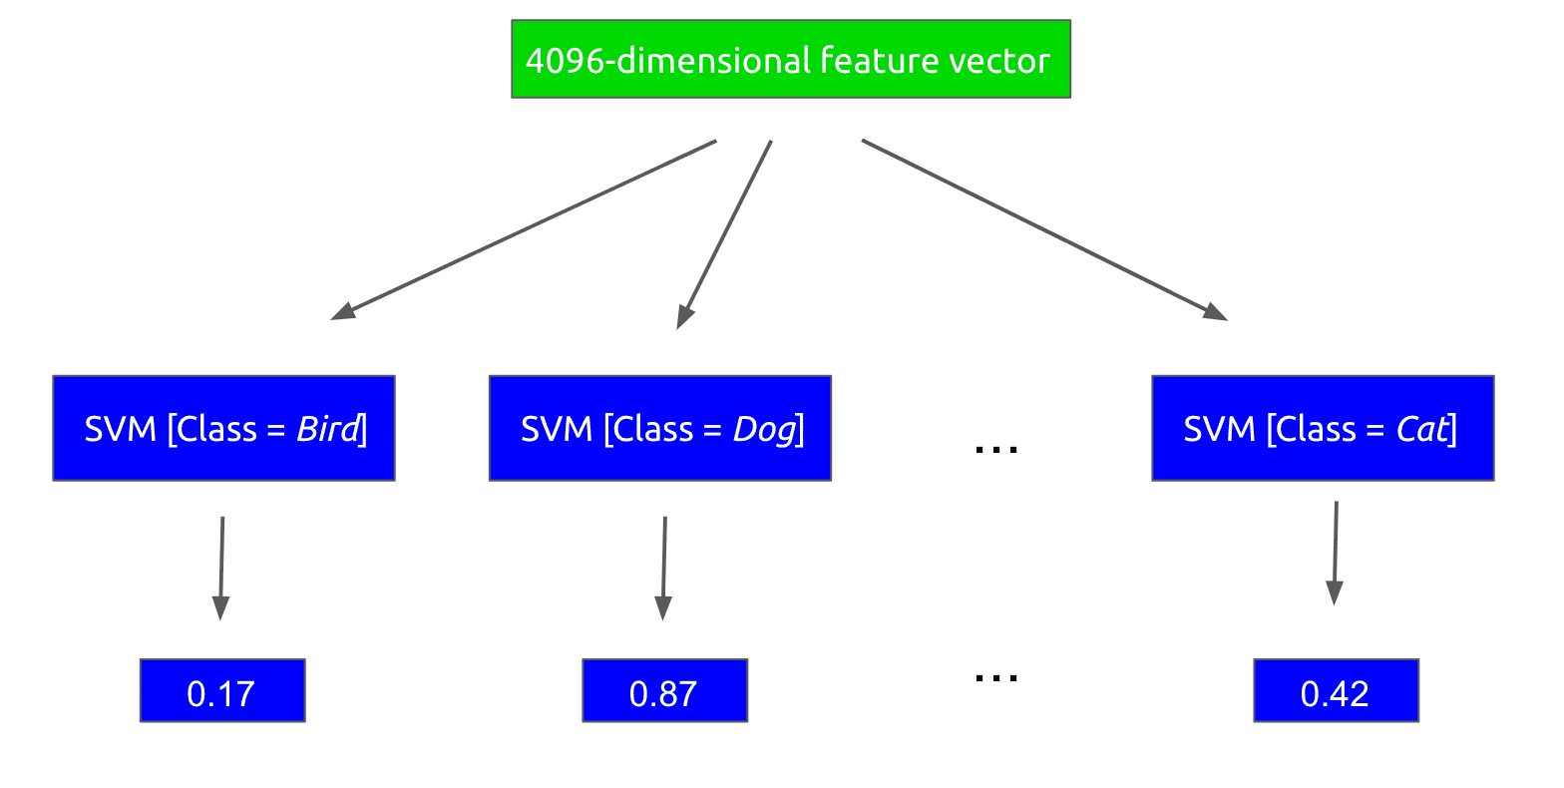
SVM for Object Classification
N pictures ✖ 2000 region proposals ✖
K+1 SVMs:
Separate linear SVMs are trained for each object category.
For any given region, each SVM determines if it belongs to its specific class.
Notes:
The method in the second row, third column of the image corresponds to isotropic scaling with padding. This approach involves the following steps:
Bounding Box Expansion: The bounding box of the region proposal is expanded to form a square by adding padding around the edges. This ensures the aspect ratio is preserved.
Context Inclusion: The padding includes a fixed number of pixels (e.g., 16) to retain some contextual information around the object.
Resizing: The expanded square region is then resized isotropically to the fixed input size required by the CNN (e.g., 227×227 pixels).

Slide 17
RCNN Overview
NMS based on IOU
https://medium.com/towards-data-science/deep-learning-for-object-detection-a-comprehensive-review-73930816d8d9
Notes:
Traditional Feature Extraction Methods
Traditional object detection methods primarily relied on handcrafted features such as SIFT (Scale-Invariant Feature Transform) and HOG (Histograms of Oriented Gradients). These features were designed to extract local gradients and texture information from images, mimicking the functionality of complex cells in the primary visual cortex (V1) of the human visual system. While these methods performed well in simple scenarios, they struggled to capture high-level semantic information in complex scenes, which limited their effectiveness in object detection tasks.
Sliding Window Detection Methods
The sliding window approach was another widely used method for object detection. This method involved sliding a fixed-size window across the image at various scales and positions, classifying each window to detect objects. However, this approach had significant drawbacks:
High Computational Cost: The exhaustive search over all possible windows made it computationally expensive, especially for high-resolution images.
Limited Adaptability: It struggled to handle the diversity of objects in terms of scale, shape, and pose, making it less effective in real-world scenarios.
Limitations of Traditional Object Detection
1. Data Scarcity
Object detection requires precise bounding box annotations for training, which are expensive and time-consuming to obtain. The scarcity of labeled data made it challenging to train high-capacity models, limiting their generalization ability and performance.
2. Performance Bottleneck
On the PASCAL VOC dataset, the performance of traditional methods stagnated between 2010 and 2012. The key performance metric, mAP (mean Average Precision), measures the average detection precision across all object categories. Traditional methods, such as the Deformable Part Models (DPM) based on HOG features, achieved an mAP of only 33.4%, with little improvement over time.
In contrast, RCNN introduced a significant breakthrough, achieving an mAP of 53.3% on the PASCAL VOC 2012 dataset, representing a relative improvement of over 30%. This marked a turning point in object detection, leveraging the power of convolutional neural networks (CNNs) and region proposals to overcome the limitations of traditional methods.

Slide 18
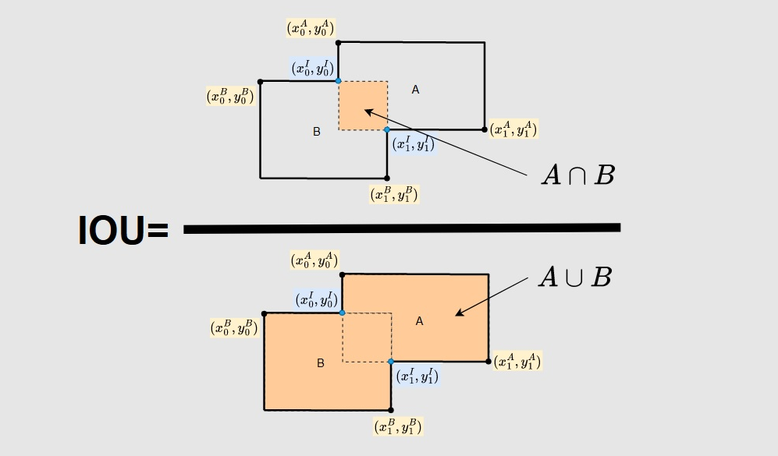
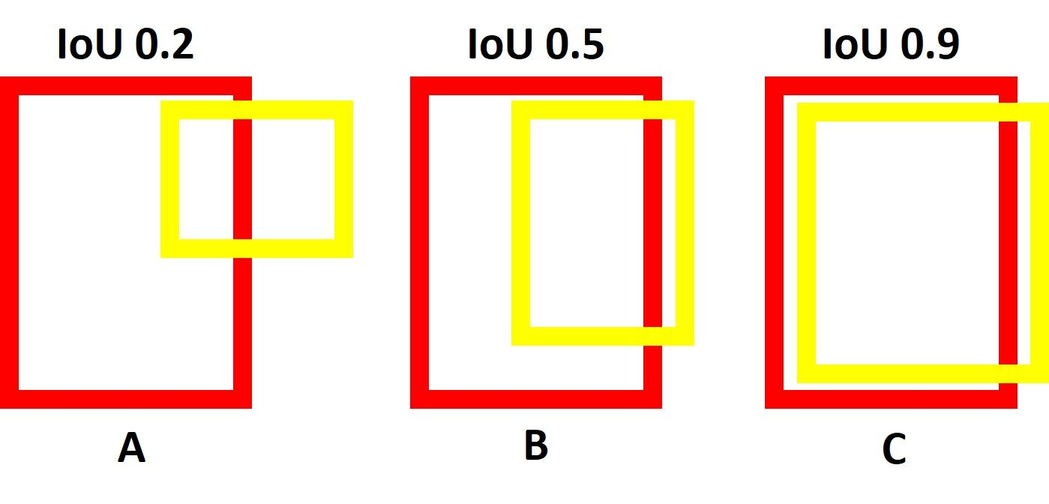
Intersection Over Union (IOU) metric
IoU (Intersection over Union) measures the overlap between region proposals and ground-truth boxes
Notes:
Traditional Feature Extraction Methods
Traditional object detection methods primarily relied on handcrafted features such as SIFT (Scale-Invariant Feature Transform) and HOG (Histograms of Oriented Gradients). These features were designed to extract local gradients and texture information from images, mimicking the functionality of complex cells in the primary visual cortex (V1) of the human visual system. While these methods performed well in simple scenarios, they struggled to capture high-level semantic information in complex scenes, which limited their effectiveness in object detection tasks.
Sliding Window Detection Methods
The sliding window approach was another widely used method for object detection. This method involved sliding a fixed-size window across the image at various scales and positions, classifying each window to detect objects. However, this approach had significant drawbacks:
High Computational Cost: The exhaustive search over all possible windows made it computationally expensive, especially for high-resolution images.
Limited Adaptability: It struggled to handle the diversity of objects in terms of scale, shape, and pose, making it less effective in real-world scenarios.
Limitations of Traditional Object Detection
1. Data Scarcity
Object detection requires precise bounding box annotations for training, which are expensive and time-consuming to obtain. The scarcity of labeled data made it challenging to train high-capacity models, limiting their generalization ability and performance.
2. Performance Bottleneck
On the PASCAL VOC dataset, the performance of traditional methods stagnated between 2010 and 2012. The key performance metric, mAP (mean Average Precision), measures the average detection precision across all object categories. Traditional methods, such as the Deformable Part Models (DPM) based on HOG features, achieved an mAP of only 33.4%, with little improvement over time.
In contrast, RCNN introduced a significant breakthrough, achieving an mAP of 53.3% on the PASCAL VOC 2012 dataset, representing a relative improvement of over 30%. This marked a turning point in object detection, leveraging the power of convolutional neural networks (CNNs) and region proposals to overcome the limitations of traditional methods.

Slide 19
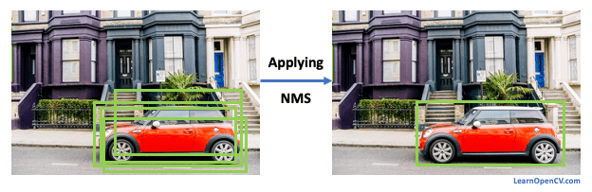
→Non-Maximum Suppression (NMS)
Intersection Over Union (IOU) metric
Scoring Regions: After extracting features for each region proposal using the CNN, the system assigns a confidence score to each region for every object class using class-specific SVMs.
Suppressing Overlaps: For each class, NMS is applied to the scored regions. If two regions have an Intersection-over-Union (IoU) overlap greater than a learned threshold, the region with the lower confidence score is suppressed (i.e., discarded).
Final Output: This process ensures that only the most confident and non-overlapping regions are retained as the final detections for each class.
Notes:
Traditional Feature Extraction Methods
Traditional object detection methods primarily relied on handcrafted features such as SIFT (Scale-Invariant Feature Transform) and HOG (Histograms of Oriented Gradients). These features were designed to extract local gradients and texture information from images, mimicking the functionality of complex cells in the primary visual cortex (V1) of the human visual system. While these methods performed well in simple scenarios, they struggled to capture high-level semantic information in complex scenes, which limited their effectiveness in object detection tasks.
Sliding Window Detection Methods
The sliding window approach was another widely used method for object detection. This method involved sliding a fixed-size window across the image at various scales and positions, classifying each window to detect objects. However, this approach had significant drawbacks:
High Computational Cost: The exhaustive search over all possible windows made it computationally expensive, especially for high-resolution images.
Limited Adaptability: It struggled to handle the diversity of objects in terms of scale, shape, and pose, making it less effective in real-world scenarios.
Limitations of Traditional Object Detection
1. Data Scarcity
Object detection requires precise bounding box annotations for training, which are expensive and time-consuming to obtain. The scarcity of labeled data made it challenging to train high-capacity models, limiting their generalization ability and performance.
2. Performance Bottleneck
On the PASCAL VOC dataset, the performance of traditional methods stagnated between 2010 and 2012. The key performance metric, mAP (mean Average Precision), measures the average detection precision across all object categories. Traditional methods, such as the Deformable Part Models (DPM) based on HOG features, achieved an mAP of only 33.4%, with little improvement over time.
In contrast, RCNN introduced a significant breakthrough, achieving an mAP of 53.3% on the PASCAL VOC 2012 dataset, representing a relative improvement of over 30%. This marked a turning point in object detection, leveraging the power of convolutional neural networks (CNNs) and region proposals to overcome the limitations of traditional methods.

Slide 20
RCNN Overview
Notes:
Traditional Feature Extraction Methods
Traditional object detection methods primarily relied on handcrafted features such as SIFT (Scale-Invariant Feature Transform) and HOG (Histograms of Oriented Gradients). These features were designed to extract local gradients and texture information from images, mimicking the functionality of complex cells in the primary visual cortex (V1) of the human visual system. While these methods performed well in simple scenarios, they struggled to capture high-level semantic information in complex scenes, which limited their effectiveness in object detection tasks.
Sliding Window Detection Methods
The sliding window approach was another widely used method for object detection. This method involved sliding a fixed-size window across the image at various scales and positions, classifying each window to detect objects. However, this approach had significant drawbacks:
High Computational Cost: The exhaustive search over all possible windows made it computationally expensive, especially for high-resolution images.
Limited Adaptability: It struggled to handle the diversity of objects in terms of scale, shape, and pose, making it less effective in real-world scenarios.
Limitations of Traditional Object Detection
1. Data Scarcity
Object detection requires precise bounding box annotations for training, which are expensive and time-consuming to obtain. The scarcity of labeled data made it challenging to train high-capacity models, limiting their generalization ability and performance.
2. Performance Bottleneck
On the PASCAL VOC dataset, the performance of traditional methods stagnated between 2010 and 2012. The key performance metric, mAP (mean Average Precision), measures the average detection precision across all object categories. Traditional methods, such as the Deformable Part Models (DPM) based on HOG features, achieved an mAP of only 33.4%, with little improvement over time.
In contrast, RCNN introduced a significant breakthrough, achieving an mAP of 53.3% on the PASCAL VOC 2012 dataset, representing a relative improvement of over 30%. This marked a turning point in object detection, leveraging the power of convolutional neural networks (CNNs) and region proposals to overcome the limitations of traditional methods.

Slide 21
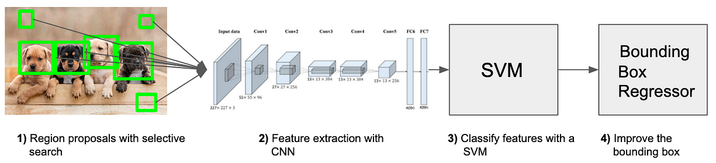
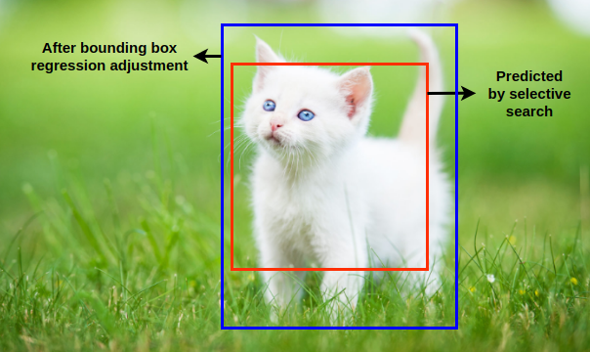
Finally we still need to refine the bounding box
https://medium.com/@selfouly/r-cnn-3a9beddfd55a

Slide 22
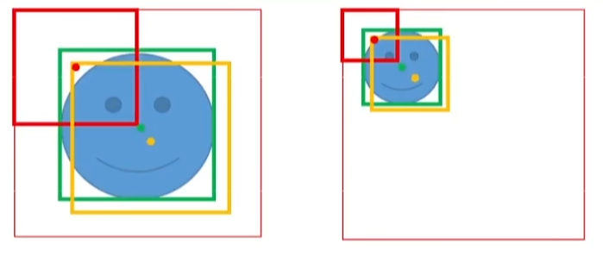
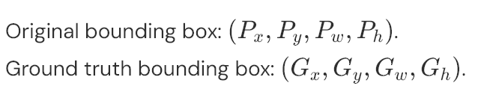
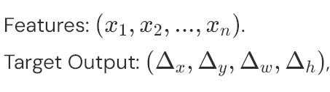
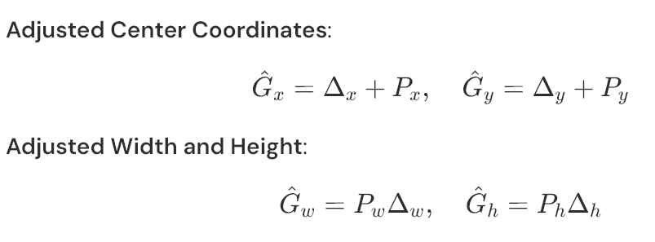
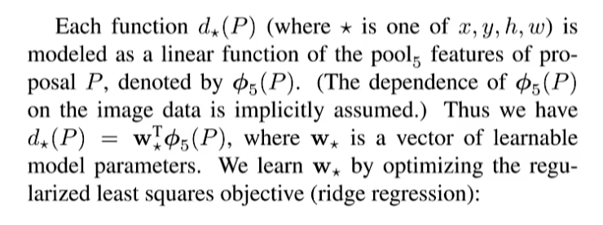
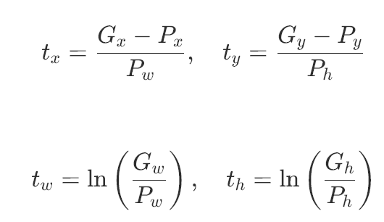
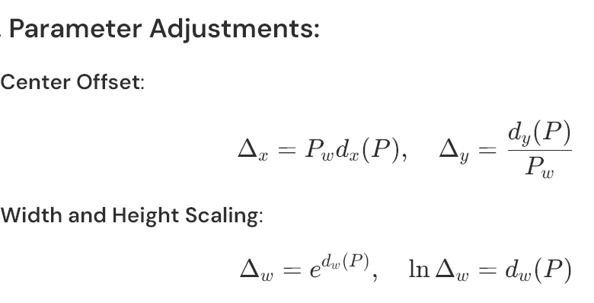
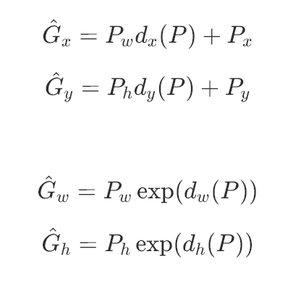
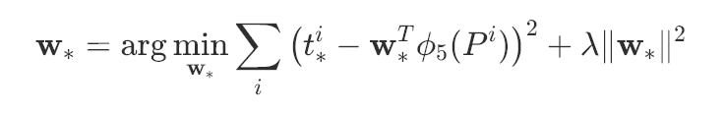
Localization: Bounding Box Regression for Precise Localization
The green box: ground truth bounding box
The yellow box: the predicted bounding box.
The red box: the initial proposed bounding box.
True Difference
Notes:
The method in the second row, third column of the image corresponds to isotropic scaling with padding. This approach involves the following steps:
Bounding Box Expansion: The bounding box of the region proposal is expanded to form a square by adding padding around the edges. This ensures the aspect ratio is preserved.
Context Inclusion: The padding includes a fixed number of pixels (e.g., 16) to retain some contextual information around the object.
Resizing: The expanded square region is then resized isotropically to the fixed input size required by the CNN (e.g., 227×227 pixels).

Slide 23
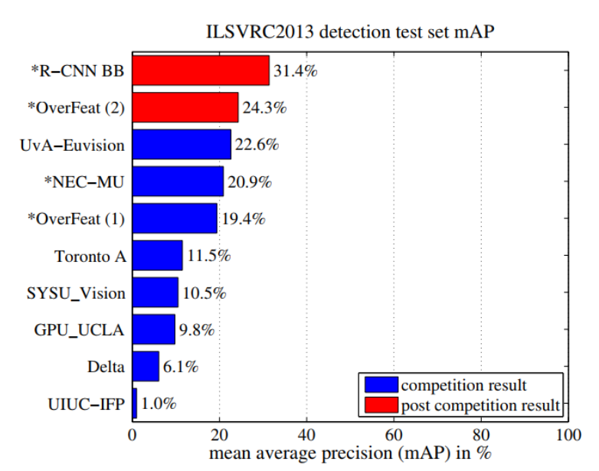
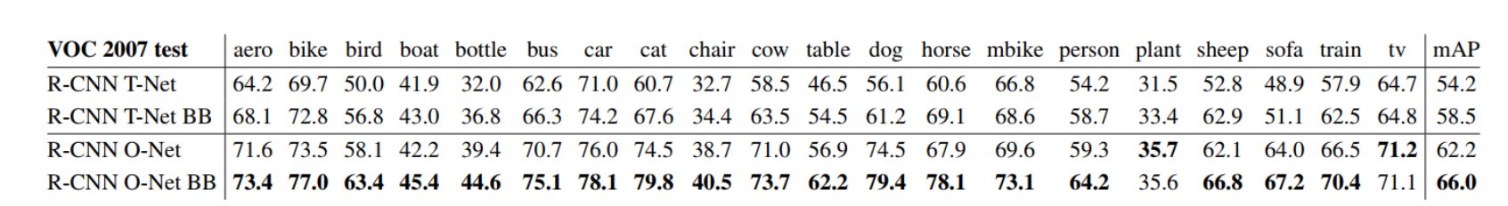
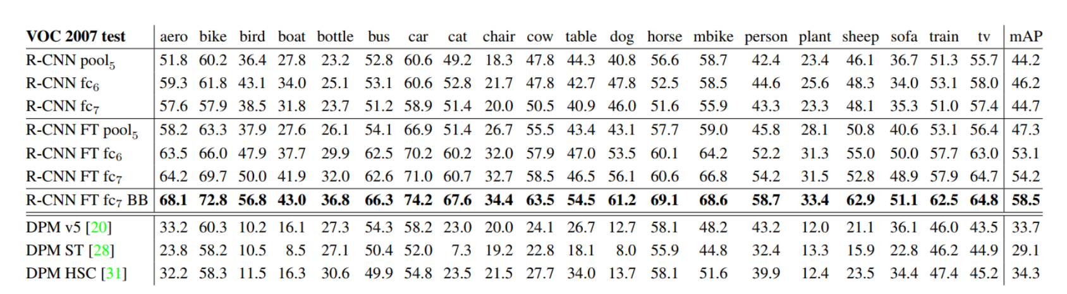
The experimental results from the RCNN paper
https://arxiv.org/abs/1311.2524
Notes:
The method in the second row, third column of the image corresponds to isotropic scaling with padding. This approach involves the following steps:
Bounding Box Expansion: The bounding box of the region proposal is expanded to form a square by adding padding around the edges. This ensures the aspect ratio is preserved.
Context Inclusion: The padding includes a fixed number of pixels (e.g., 16) to retain some contextual information around the object.
Resizing: The expanded square region is then resized isotropically to the fixed input size required by the CNN (e.g., 227×227 pixels).

Slide 24
Slow R-CNN
1. Ad hoc training objectives
(i) Fine-tune network with softmax classifier (log loss)
(ii) Train post-hoc linear SVMs (hinge loss)
(iii) Train post-hoc bounding-box regressions (least squares)
2. Training is expensive in space and time.
84h, takes a lot of disk space
2.5 GPU-days for 5k images
3. Inference (detection) is slow.
47s/image with VGG16

Slide 25
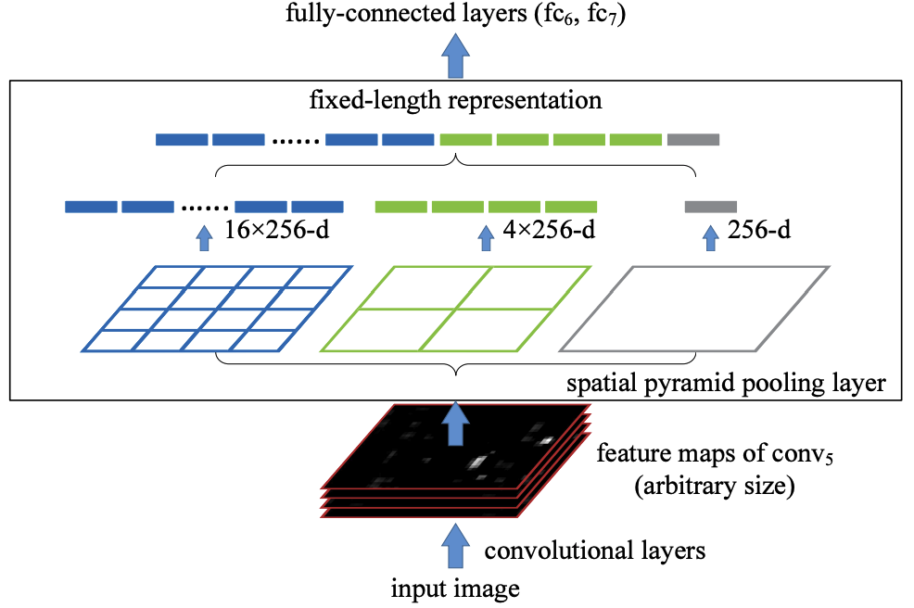
Solutions1: Sharing Computation
Spatial pyramid pooling networks (SPPnets)
(i) computes a convolutional feature map for the entire input image
(ii)classifies proposal using a feature vector extracted from the shared feature map.
source: arXiv:1406.4729 [cs.CV]

Slide 26
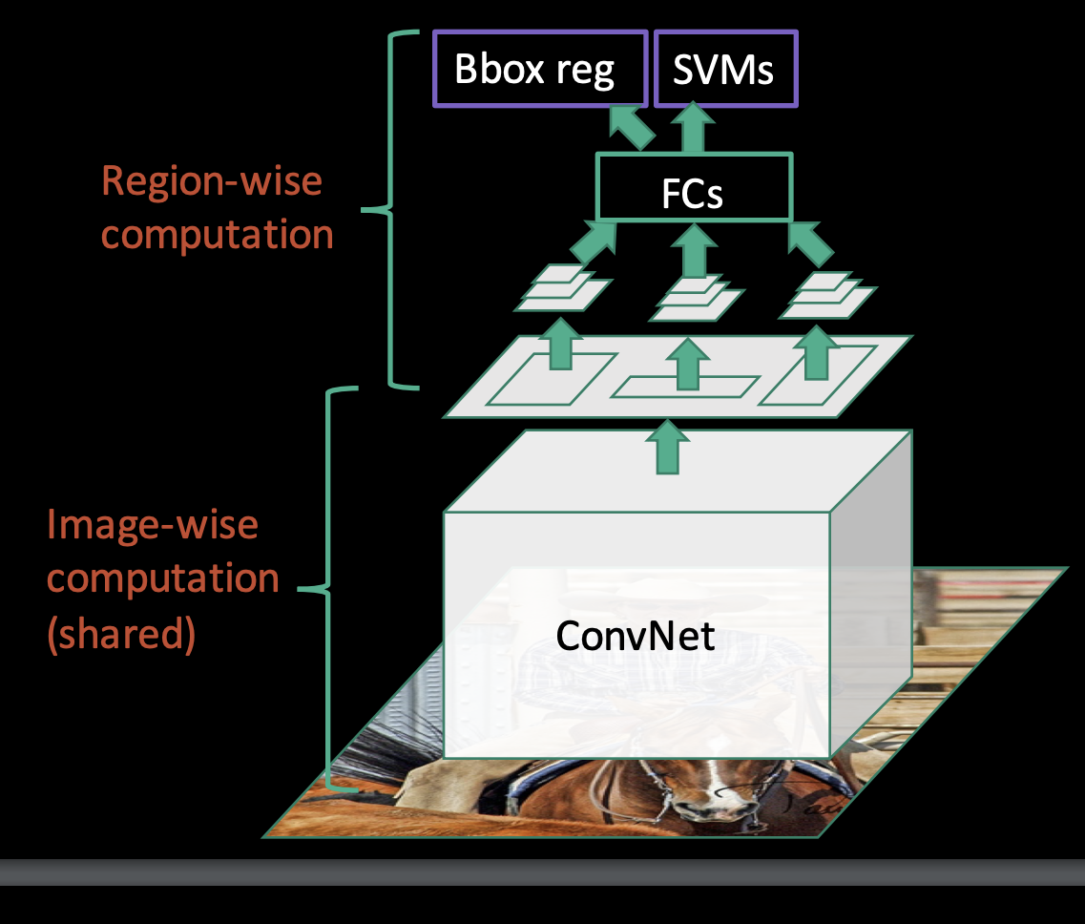
SSPnet
Pro: Fixes one issue with R-CNN: speed up inference time
source: https://www.robots.ox.ac.uk/~tvg/publications/talks/fast-rcnn-slides.pdf

Slide 27
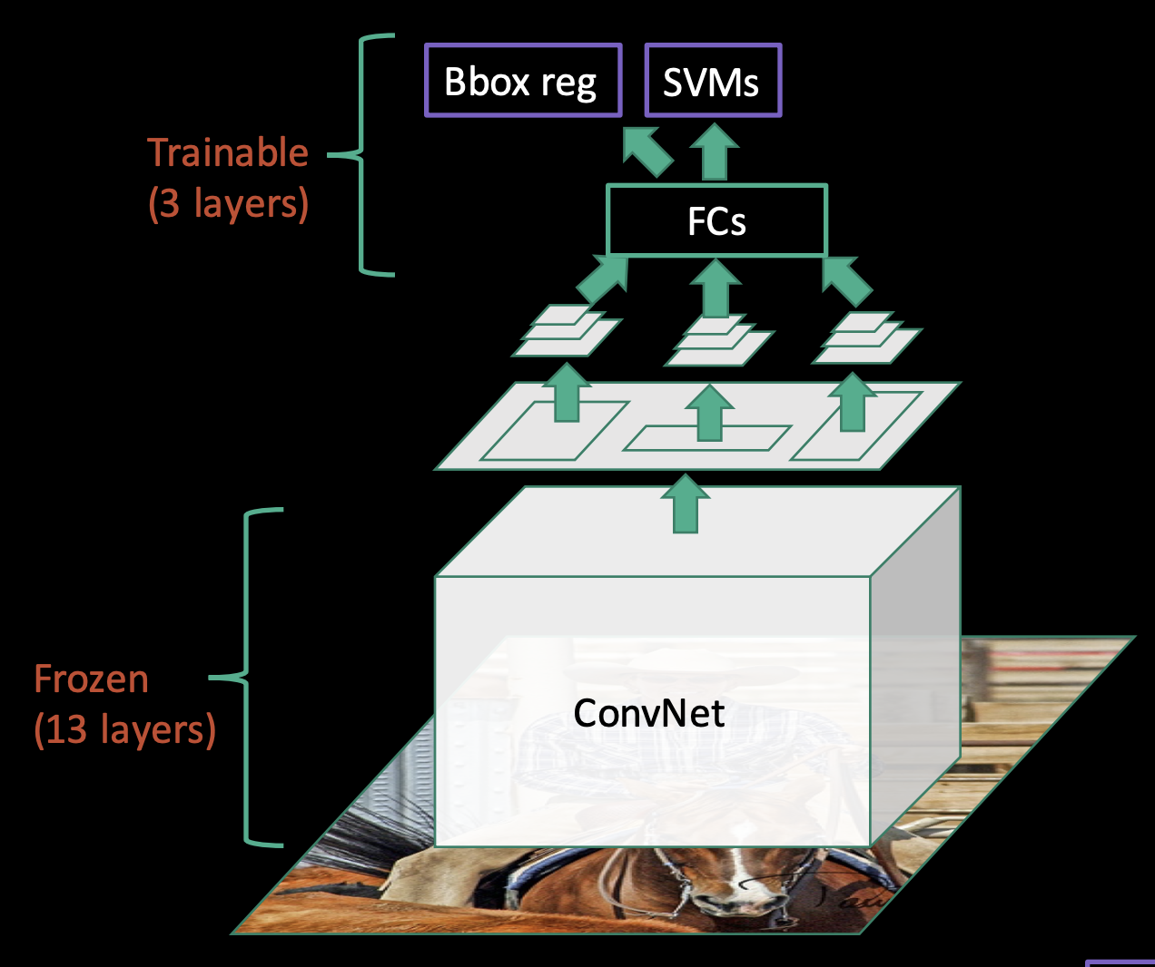
Limitation of SSPnet
Cons:
1.Training is a multi-stage pipeline
2.Cannot update parameters below SPP layer during training
source: https://www.robots.ox.ac.uk/~tvg/publications/talks/fast-rcnn-slides.pdf

Slide 28
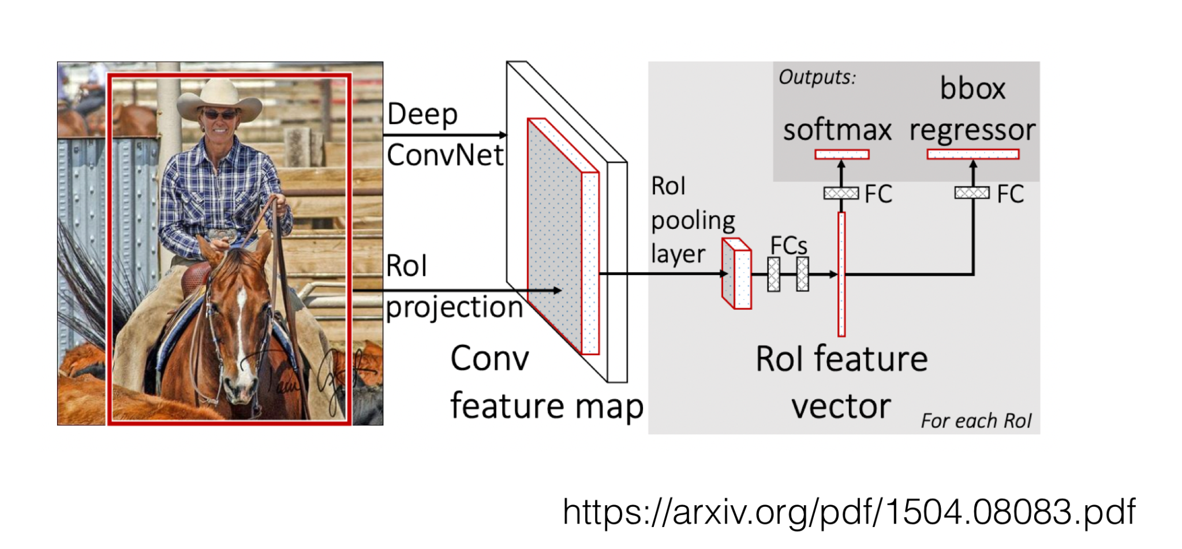
Fast R-CNN
1. Higher detection quality (mAP) than R-CNN, SPPnet
2. Training is single-stage, using a multi-task loss
3. Training can update all network layers
4. No disk storage is required for feature caching

Slide 29
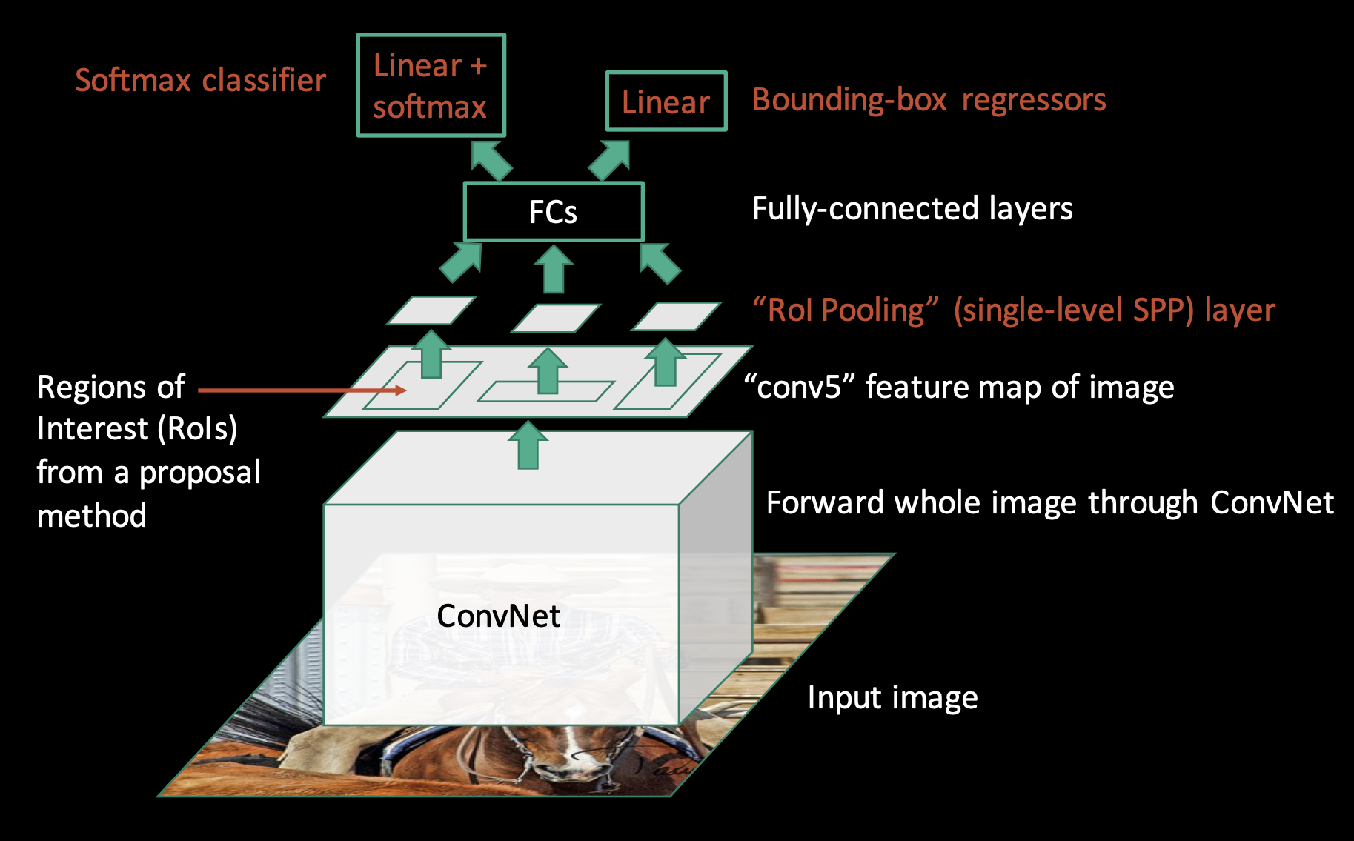
Fast R-CNN
source: https://www.robots.ox.ac.uk/~tvg/publications/talks/fast-rcnn-slides.pdf

Slide 30
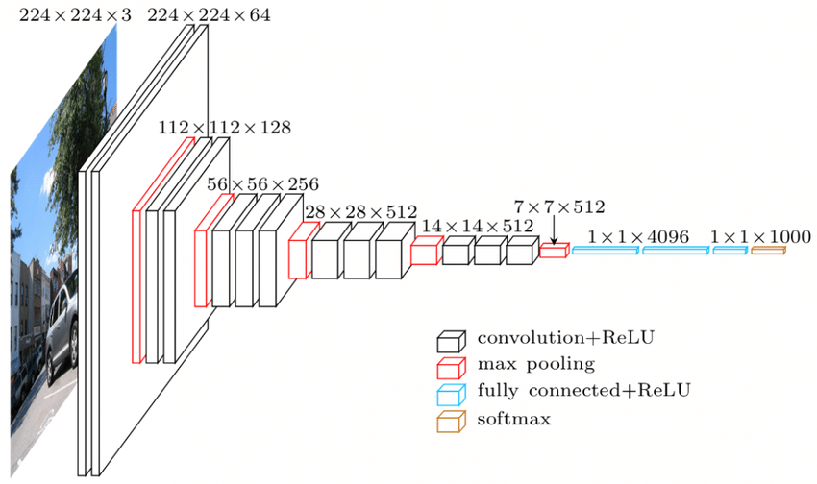
Pre-trained Networks: VGG16

Slide 31
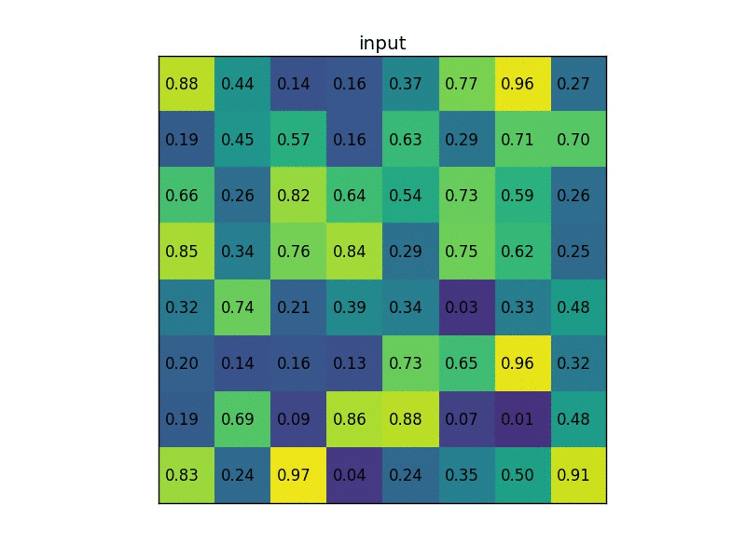
ROI pooling layer

Slide 32
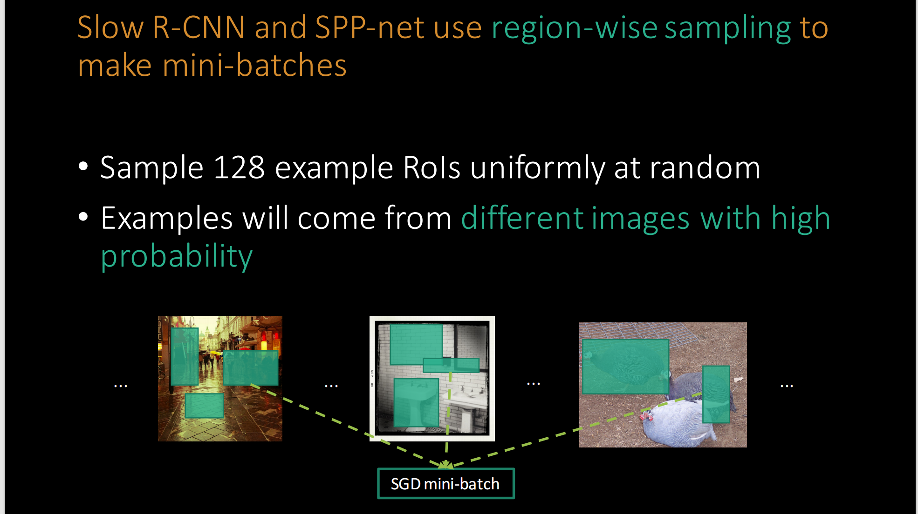
Training Improvement
source: https://www.robots.ox.ac.uk/~tvg/publications/talks/fast-rcnn-slides.pdf

Slide 33
Hierarchical Training
In Fast R-CNN training, stochastic gradient descent (SGD) mini-batches are sampled hierarchically, first by sampling N images and then by sampling R/N RoIs from each image.
For example, when using N = 2 and R = 128, the proposed training scheme is roughly 64×faster than sampling one RoI from 128 different images (i.e., the R-CNN and SPPnet strategy).

Slide 34
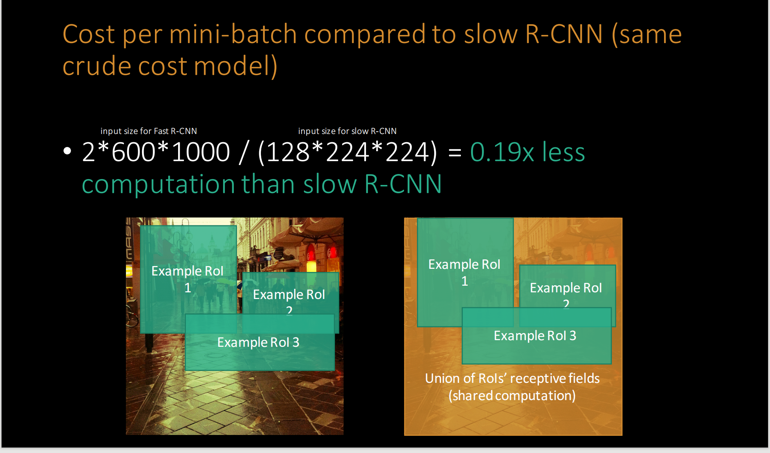
source: https://www.robots.ox.ac.uk/~tvg/publications/talks/fast-rcnn-slides.pdf

Slide 35
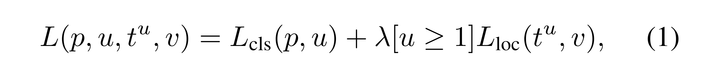
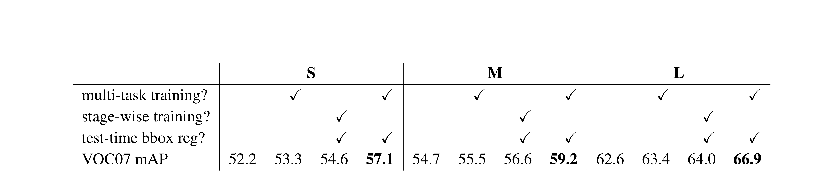
Does multi-task training help?
It avoids managing a pipeline of sequentially-trained tasks. But it also has
the potential to improve results because the tasks influence each other through a shared representation.
source: arXiv:1504.08083 [cs.CV]

Slide 36
Results
 | Fast R-CNN | R-CNN [1] | SPPnet [2]
Train time (h) | 9.5 | 84 | 25
Speedup | 8.8x | 1x | 3.4x
Test time/image | 0.32s | 47.0s | 2.3s
Test speedup | 146x | 1x | 20x
mAP | 66.9% | 66.0% | 63.1%
Timings exclude object proposal time, which is equal for all methods.
All methods use VGG16 from Simonyan and Zisserman.
[1] Girshick et al. CVPR14.
[2] He et al. ECCV14.
source: arXiv:1504.08083 [cs.CV]

Slide 37
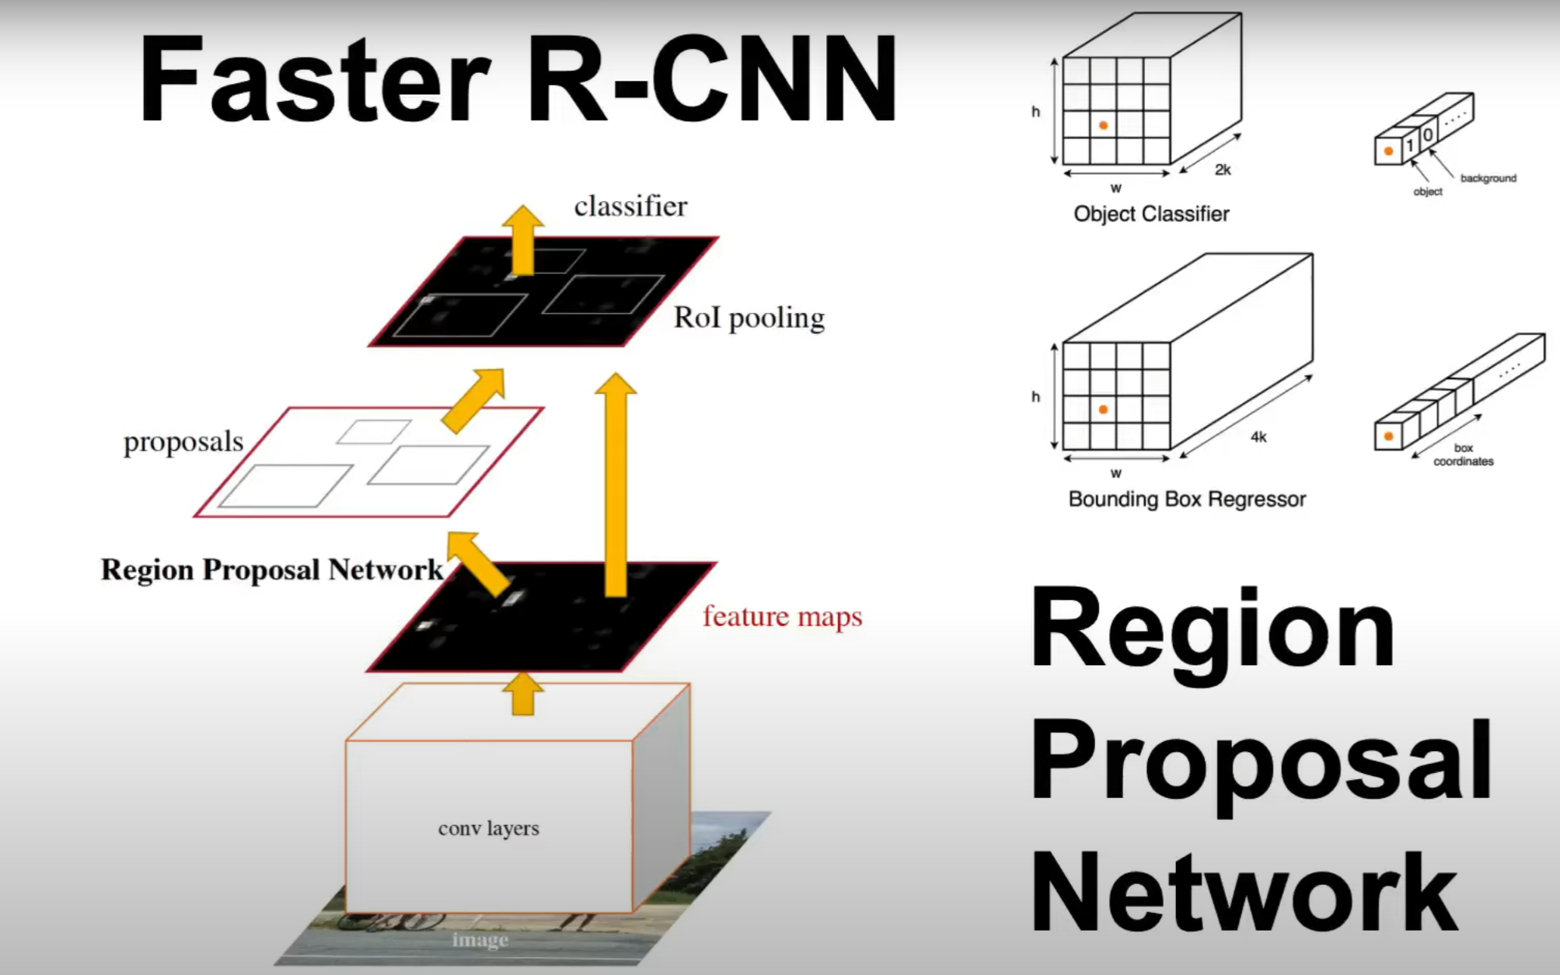

Outline of the Presentation
Quick recap of R-CNN and Fast R-CNN
Motivation behind Faster R-CNN
Deep dive into its architecture
Key components:
Region Proposal Network (RPN)
RoI Pooling
Training strategy & performance gains
Summary and Q&A
https://arxiv.org/pdf/1506.01497

Slide 38

Quick recap of R-CNN and Fast R-CNN
R-CNN:
Selective search for region proposals
CNN for each region independently
Limitation:
Slow due to redundant computation
Fast R-CNN:
Shared convolutional features across regions
RoI Pooling to handle variable sizes
Remaining Issue:
Still relies on external region proposals
https://lilianweng.github.io/posts/2017-12-31-object-recognition-part-3/

Slide 39

Motivation for Faster R-CNN
Why Faster R-CNN?
Need for a unified, end-to-end trainable system
Eliminate the bottleneck of external region proposals
Achieve real-time object detection without sacrificing accuracy
Key Points:
Efficiency improvement
Simplified pipeline
Enhanced speed and performance
https://arxiv.org/pdf/1311.2524

Slide 40

In-Depth: The Region Proposal Network (RPN)
What is RPN?
A fully convolutional network that generates region proposals
Key Concepts:
Anchor Boxes: Fixed set of boxes at different scales and aspect ratios Predicts both objectness scores and refined bounding box coordinates

Slide 41


Deep dive into its architecture
How the Region Proposal Network (RPN) is integrated into the CNN?
https://www.telesens.co/2018/03/11/object-detection-and-classification-using-r-cnns/

Slide 42

Training Strategy & Multi-Task Loss
Joint Training Approach:
End-to-end training that optimizes both the RPN and detection network together
Multi-Task Loss:
Combines classification (object vs. background) and bounding box regression loss
Benefits:
Faster convergence and improved detection accuracy
https://medium.com/@RobuRishabh/understanding-and-implementing-faster-r-cnn-248f7b25ff96

Slide 43
Training Details
• Main Objective – Two tasks for each region:
Classification (object & background) & Regression (refining coordinates).
• Loss Functions – RPN Loss: Classification (foreground vs. background) + Regression (Smooth L1) – ROI Loss: Classification (target class + background) + Regression (Smooth L1) – Overall: weighted sum of RPN + ROI losses
• Optimizer & Hyperparameters Typically Stochastic Gradient Descent (momentum=0.9, weight decay=0.0005) • 4-Step Training Framework
Train RPN (using backbone pretrained on ImageNet)
Fix RPN, train ROI detection head
Fix ROI head, fine-tune RPN again
Jointly fine-tune both (end-to-end)

Slide 44
Experimental Results from Original Paper
• Datasets & Metrics – Evaluated on PASCAL VOC (mAP) and MS COCO (AP@IoU thresholds) – Compared ZF (5-layer) vs. VGG16 (16-layer) backbones
• Main Results – Faster than previous two-stage methods (e.g., using Selective Search) – Achieves state-of-the-art mAP on VOC 2007/2012 – Near real-time proposals with high recall
• Ablations & Comparisons – Demonstrated benefit of sharing convolutional features between RPN and detection head – Explored different anchor scales/aspect ratios – Compared 4-step alternate training vs. single-stage training
• Highlights – Eliminates external proposal generation – Sets foundation for many subsequent detection frameworks – Balances efficiency (speed) and accuracy effectively

Slide 45



Performance & Real-World Impact
Speed and Accuracy Improvements:
 | R-CNN | Fast R-CNN | Faster R-CNN
Test Time/Image | 50 seconds | 2 seconds | 0.2 seconds
Speed-up | 1x | 25x | 250x
mAP(VOC 2007) | 66.0% | 66.9% | 66.9%
Zero Shot Inference on PennFudan Image Set by Faster R-CNN model pre-trained on COCO 2017

Slide 46
Summary & Key Takeaways
Main Points Recap:
The evolution from R-CNN → Fast R-CNN → Faster R-CNN
Integration of the RPN and the pivotal role of RoI Pooling
End-to-end training via multi-task loss for improved performance
Faster R-CNN’s Performance & Current Extensions
Achieves near SOTA accuracy on datasets like PASCAL VOC and MS COCO.
Merges RP & detection in one network, significantly reducing inference time.
Forms the foundation of advanced techniques such as Mask R-CNN and is widely adapted for tasks in autonomous driving, medical imaging, and beyond.
Final Message:
Faster R-CNN significantly advances object detection by combining efficiency with high accuracy

Slide 47
Q&A and Further Resources
Questions:
Open the floor for a brief Q&A session
Further Reading:
https://lilianweng.github.io/posts/2017-12-31-object-recognition-part-3/
https://medium.com/@RobuRishabh/understanding-and-implementing-faster-r-cnn-248f7b25ff96
https://www.digitalocean.com/community/tutorials/faster-r-cnn-explained-object-detection
Our Tutorial on Course Github

